Slide 1

Medical Device Report
Becky Joseph & Essi Monneus

Slide 2
Some of the questions we had…
Alternative Hypothesis: If the Type 1 device trend is the same over time then it will have the same percentage in any year.
Null Hypothesis: If the Type 1 device trend is not the same over time then it will not have the same percentage in any year.
Alternative Hypothesis: If medical devices have become more reliable in 2020, then the number of recalls will be less than in 1995?
Null Hypothesis: If medical devices have not become more reliable in 2020, then the number of recalls will be not be less than in 1995?

Slide 3
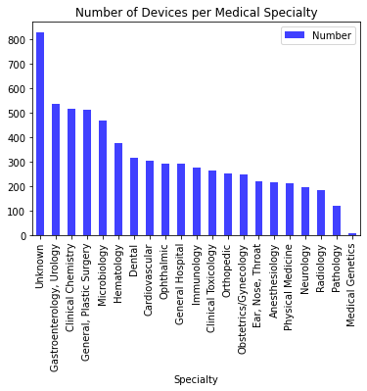
The Medical Specialty in the FDA Database
Using the API provided by the FDA, data of various Medical Devices were obtained.
This devices can be grouped in the categories shown on the “Number of devices per Medical Specialty” graph.

Slide 4
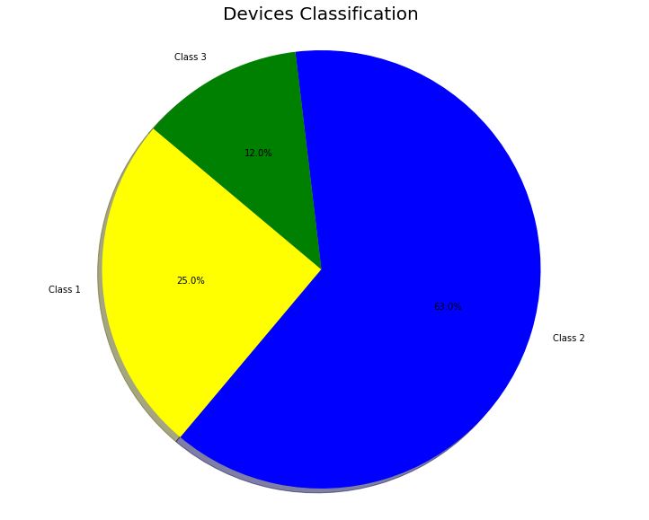
The Medical Devices Classification
Depending on the risk that the device represent for a patient, medical devices can be listed into different classes.
Class 1 has low to moderate risk
Class 2 has moderate to high risk
Class 3 has really high risk
Of all the devices in the FDA’s database, the majority were class 2 devices.

Slide 5
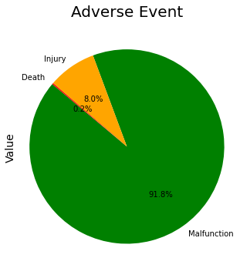
Adverse Events Related to Medical Devices
Unfortunately, some devices do not meet the quality standards.
When defective devices are used on patient it can lead to an adverse event: Malfunction during a diagnosis, Injury or even death.

Slide 6
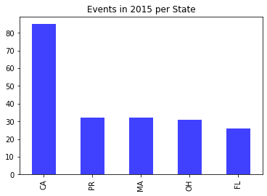
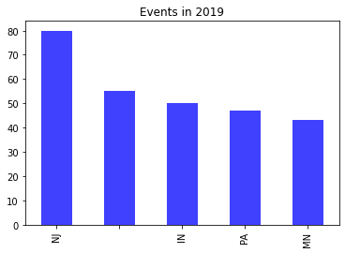
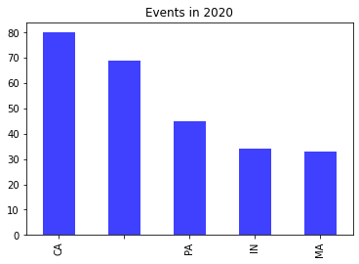
Analysis of Adverse Events versus Years
For the state of California for example, >80 adverse events were registered in 2015. Five(5) years later, the adverse event number is interestingly around 80.

Slide 7
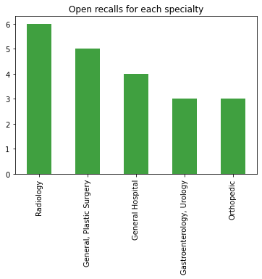
Medical Devices Recalls
When a company registers too many adverse events with their devices, the FDA can order a recall. This prevents more customers from being harmed.
Here are the open recalls per medical specialty in the FDA database.

Slide 8
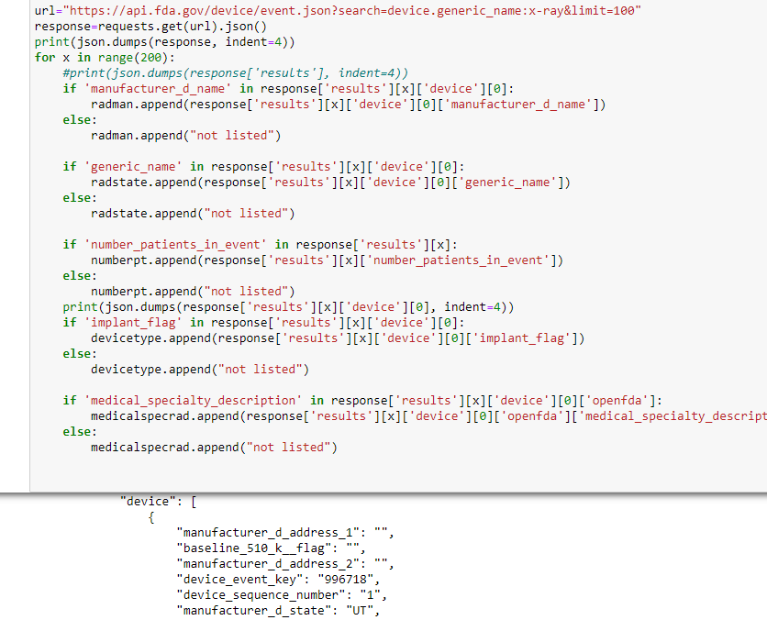
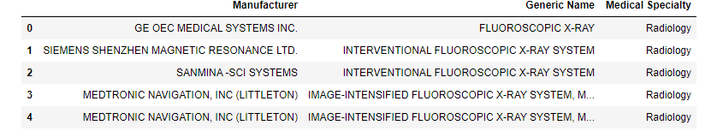
Medical Device Events In Radiology
Radiology had the highest amount of open recalls. Narrowing in on which manufacturers and types of equipment had the most issues.

Slide 9
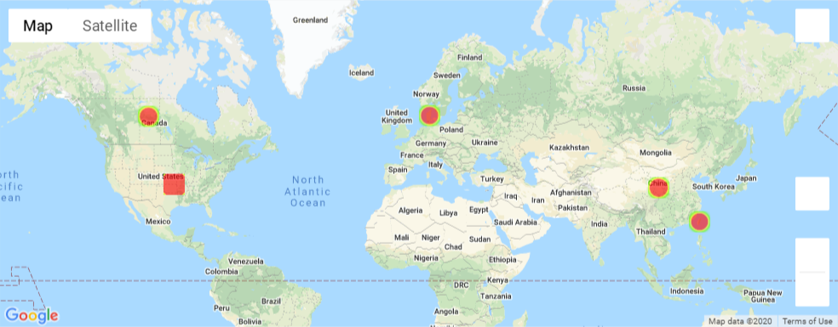
Top manufacturers of devices across the world

Slide 10
Conclusions:
More data was needed
Limited user input
The size of the files were too big

Slide 11
Questions?

